Slide 1


Designing and simulating the circuit at the op-amp transistor level 741 professor name : Amir Fathi Student name : Alireza Alivand Faculty of Electrical and Computer Engineering, Urmia University Electronics 1

Slide 2
Contents : 1.Circuit analysis
2.Characteristics of circuit transistors
3.Hspice Code
4.Manual circuit analysis
.5Simulation

Slide 3
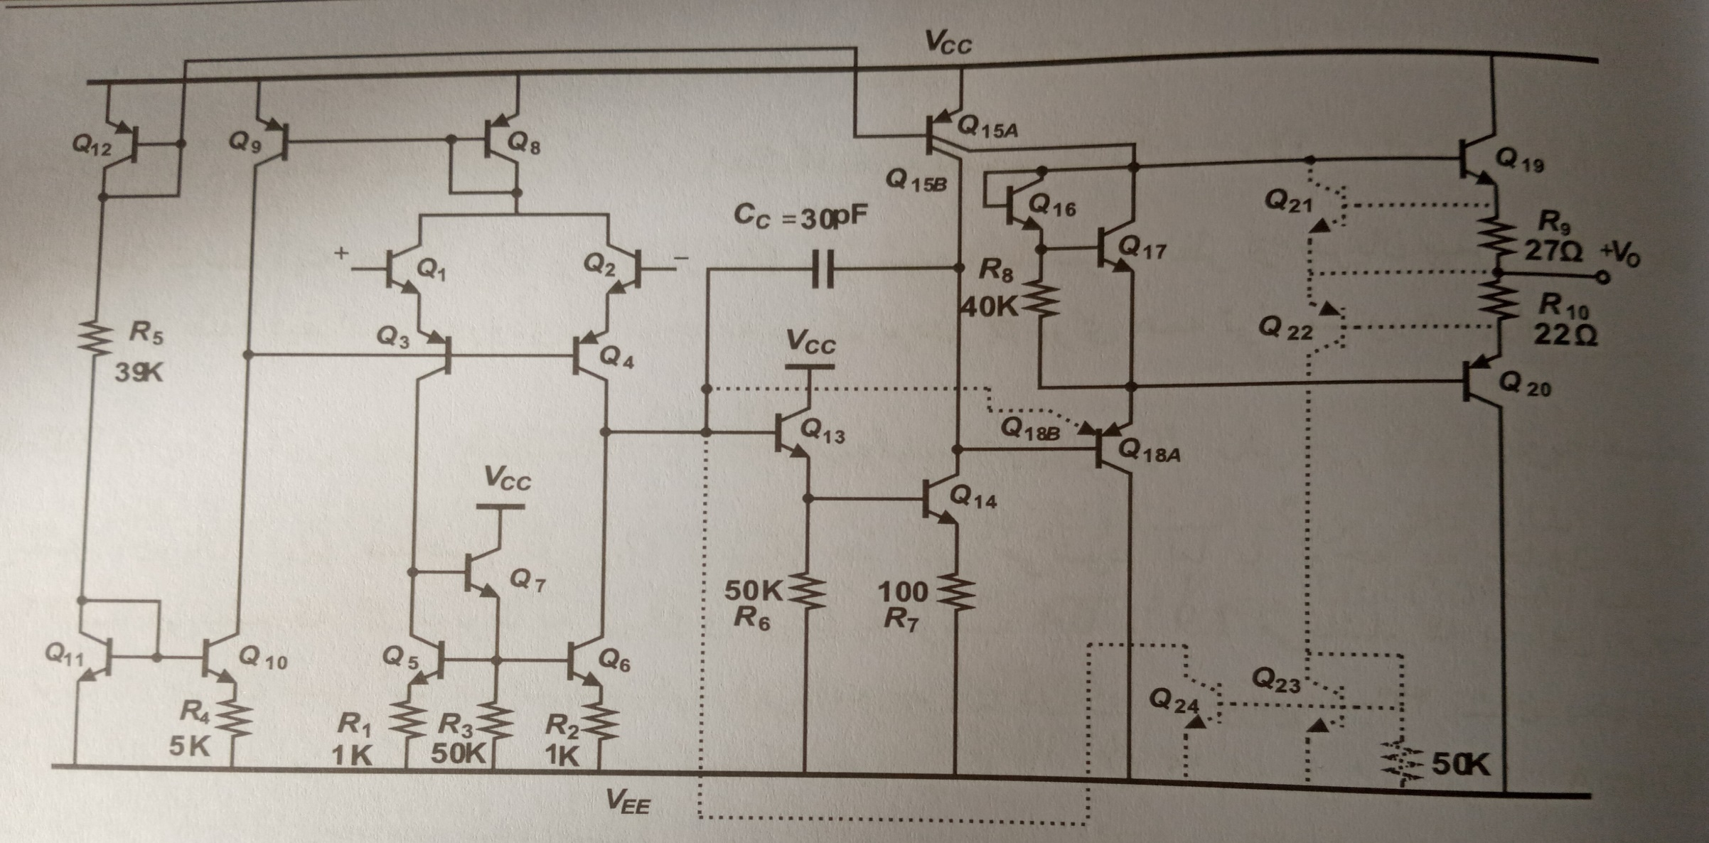

Slide 4
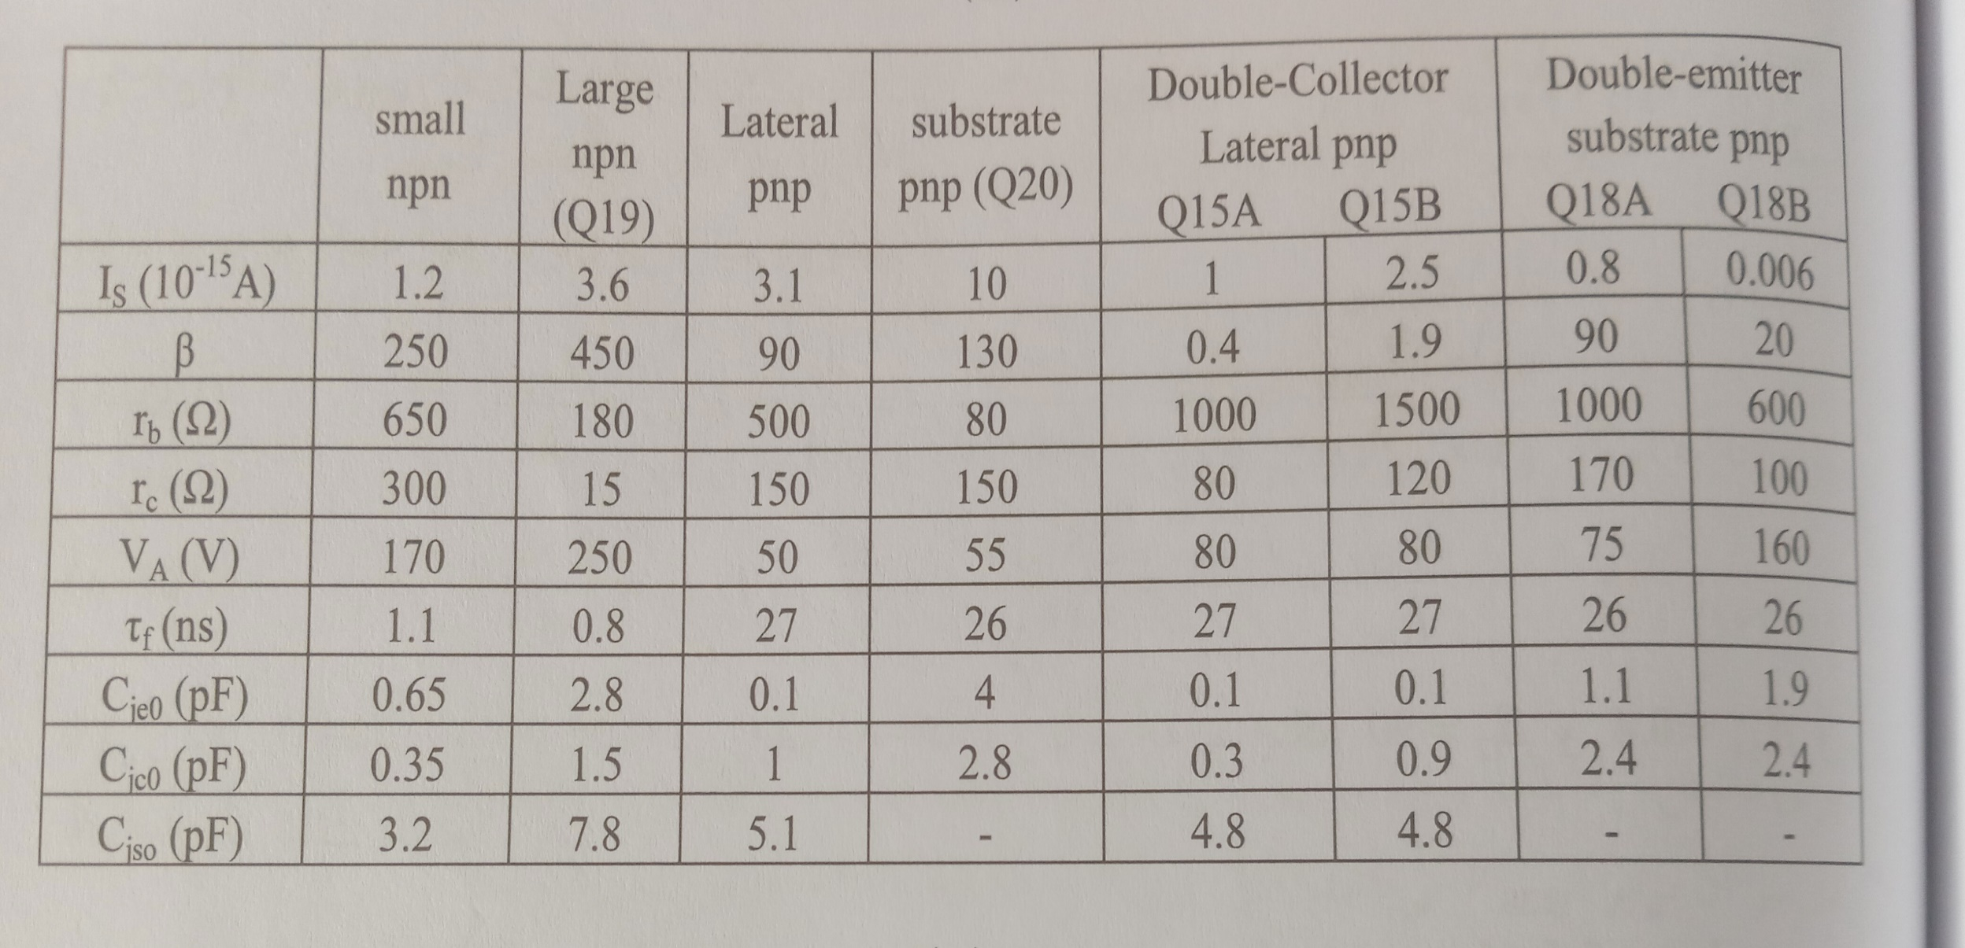

Slide 5
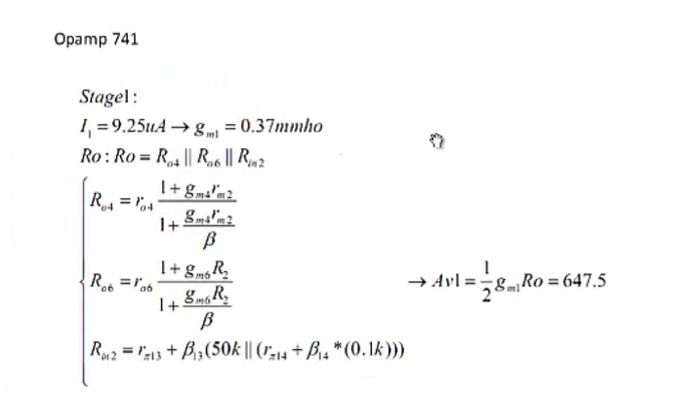

Slide 6
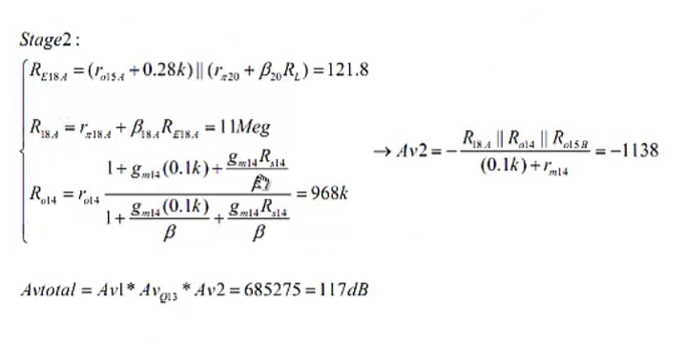

Slide 7
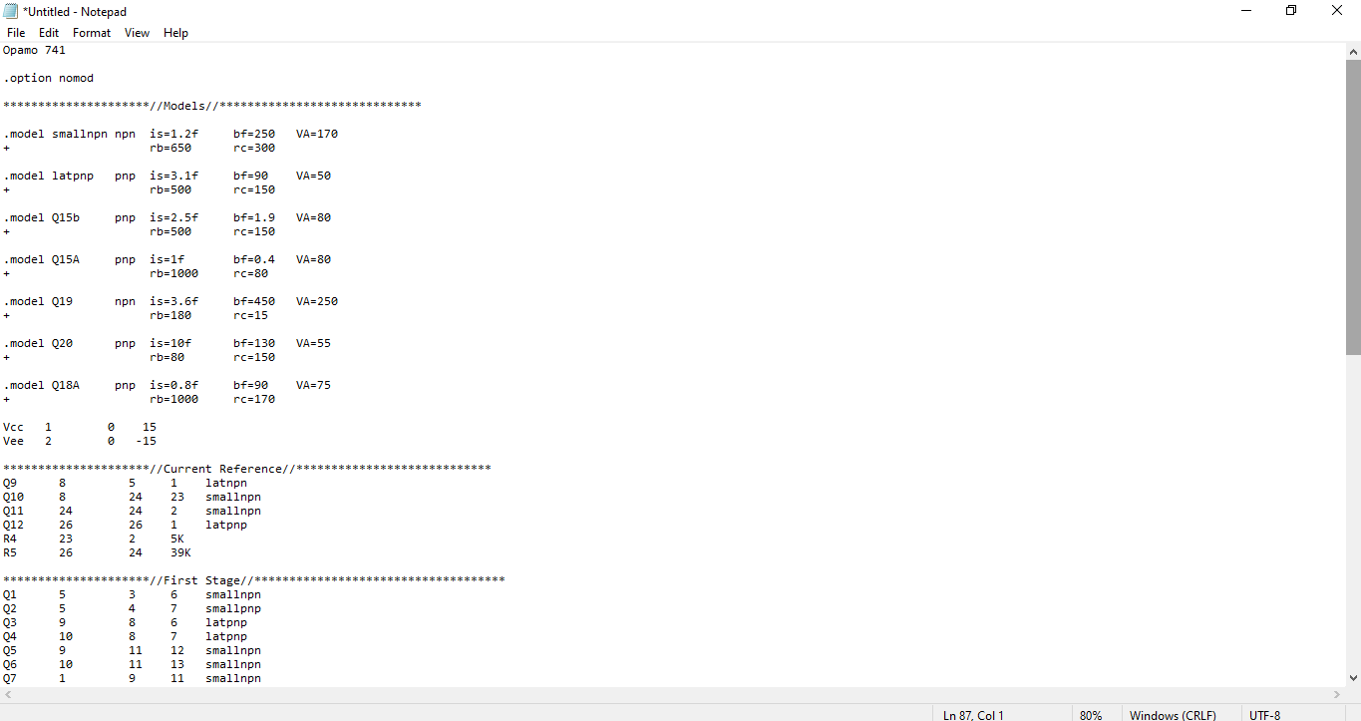

Slide 8
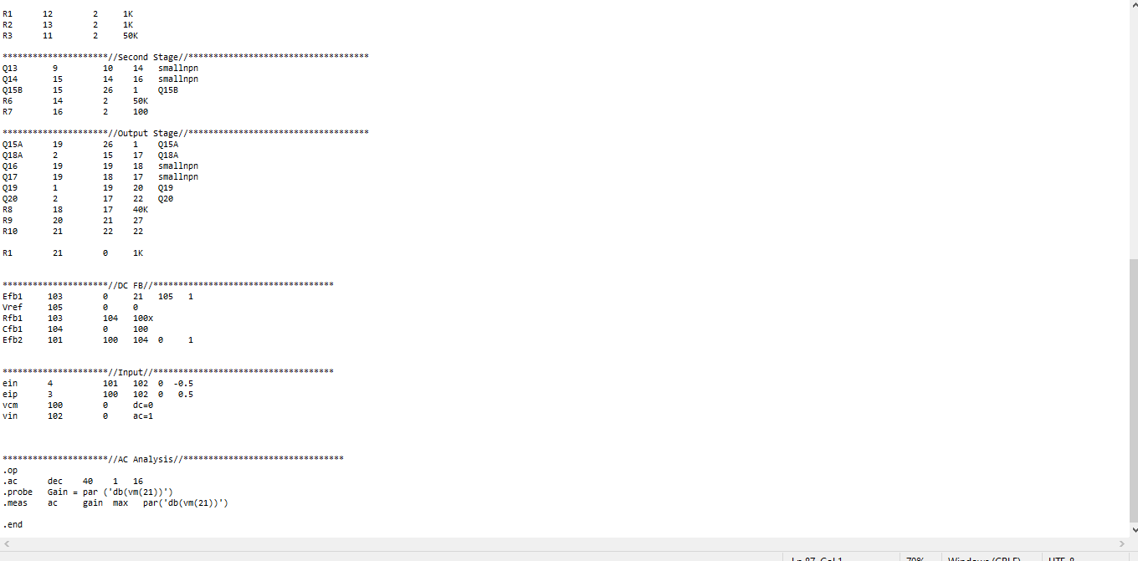

Slide 9
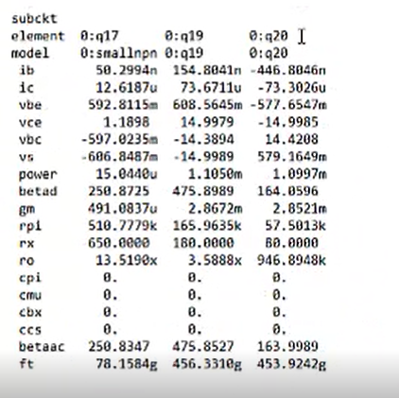
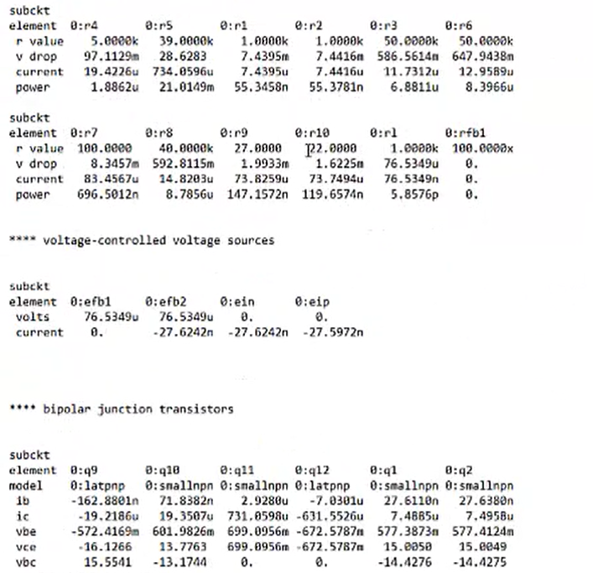

Slide 10
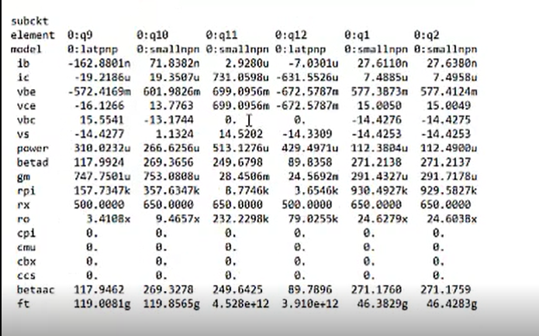
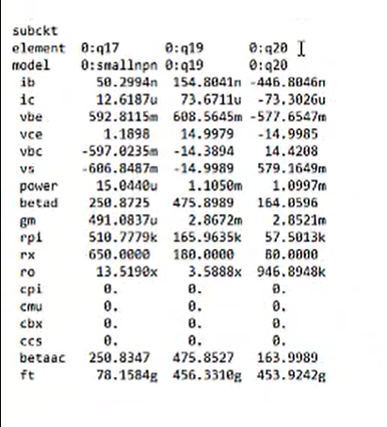

Slide 11
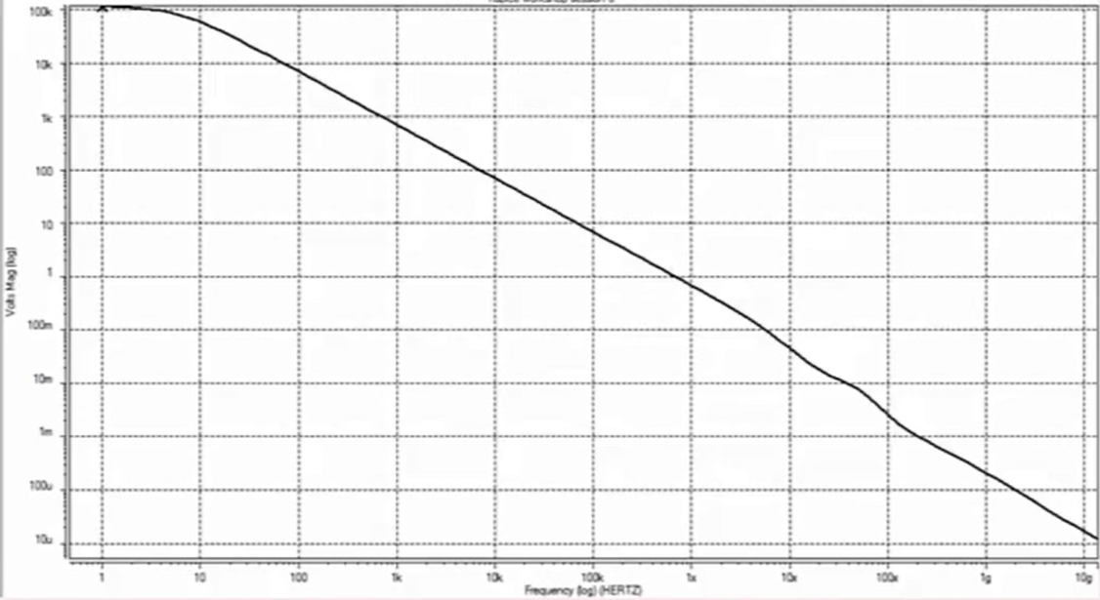

Slide 12
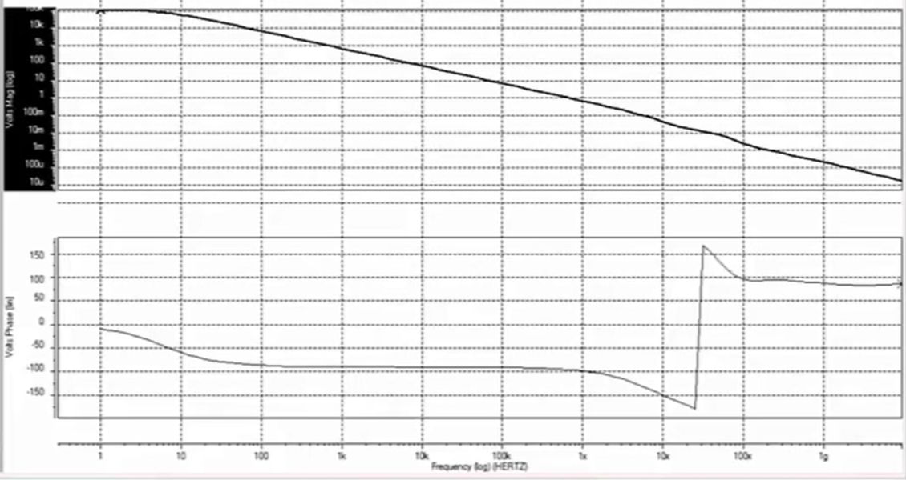

Slide 13


